Slide 1
Natural Language Processing and Chatbots
Bryan Barton

Slide 2
Proposal
This project seeks to create chatbots based upon dialogue for a popular television show.
Using scripts that are posted online, process the lines a dialogue in a way to can be used for analysis.
Each chatbot will correspond to each of the main characters in the show and also have the ability to talk to each other.
They will work by comparing user input and matching the best line of dialogue from the dataset.

Slide 3
Dataset
The data available online are episode scripts posted online that have each line of dialogue assigned to a specific character.
The shows first 18th seasons have been collected and compiled into a single CSV file with each entry indicating the character, season, episode, and line of dialogue.
Minimal cleaning was needed since there are no missing values in the data.
Three characters were discovered to have the majority of the lines of dialogue: Cartman, Kyle, and Stan compared to all other characters.

Slide 4
Wrangling
While our dataset has numerical information, it is not used for the purposes of the project since we will be dealing only with dialogue from the show labeled “Line.”
The column labeled “Character” is only used to grab all instances of our main characters dialogue.
The column labeled “Line” is the information that is used for the project as is stored lines of dialogue.
This means we need to preprocess this data so it can become usable.

Slide 5
Preprocessing
Preprocessing is applied twice in this project: first it is used for each line of dialogue of the three main characters and second it is used for the user input when asking what their question is.
The reason for this is because we will be comparing the similarities between two in able to determine what the best response will be input.
This also means it can be applied multiple times in order to create a conversation loop between the chatbots after the initial user input.

Slide 6
Preprocessing Steps
Preprocessing is a multi-stage process that converts text into a form that is predictable and analyzable for our task. This means the steps we take are not the same for every task but are the most appropriate for our particular dataset.
The steps taken in order are:
1 Expand Contractions | 5 Remove stop words
2 Lowercase letters | 6 Remove punctuation
3 Remove numbers | 7 Tokenize
4 Spell check | 8 Lemmatize

Slide 7
Tokenize and Lemmatize
Tokenization is the process of breaking down the lines of dialogue into simple units called tokens. For example, taking a string “I love you” and tokenizing it will return a list of [“I”, “love”, “you”].
Immediately after we tokenized the data, we also lemmatize it as well which is the conversion of the word to its dictionary form called a lemma. This means a word that is used in different inflection such as run, running, ran, and runs will all be grouped as one word.

Slide 8
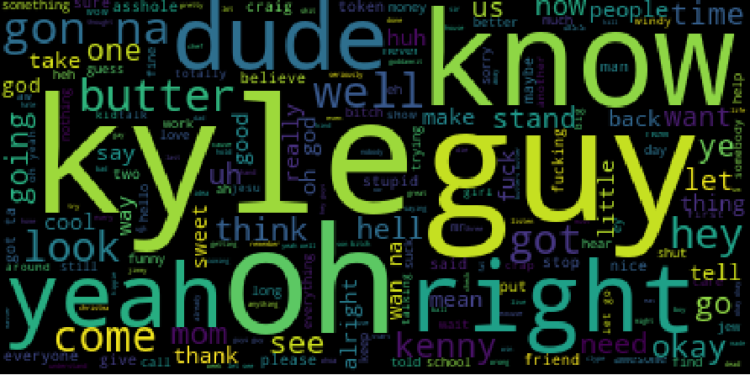
Cartman Most Common Words

Slide 9
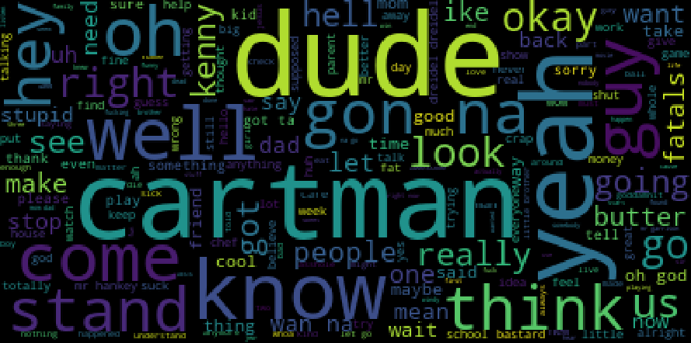
Kyle Most Common Words

Slide 10
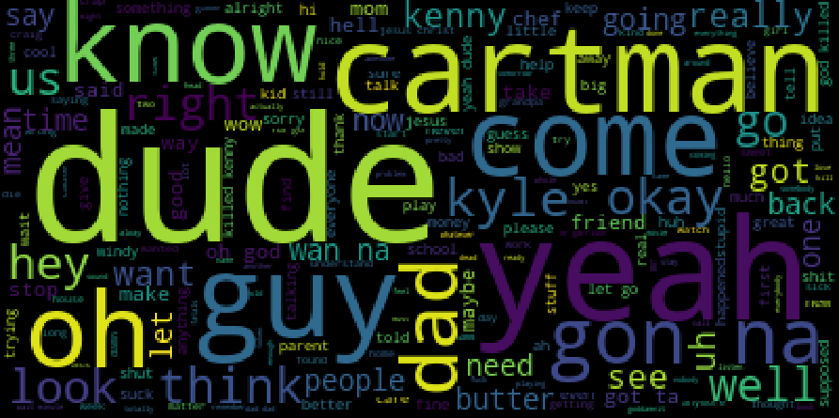
Stan Most Common Words

Slide 11
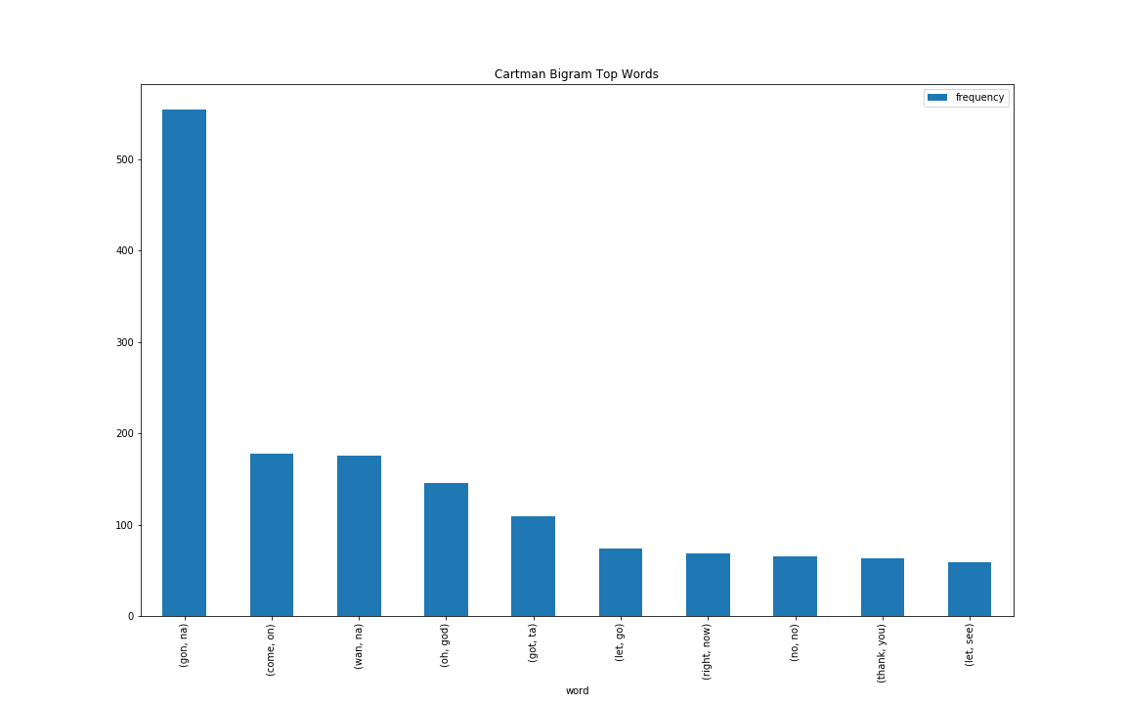
Cartman Bigram Top Words

Slide 12
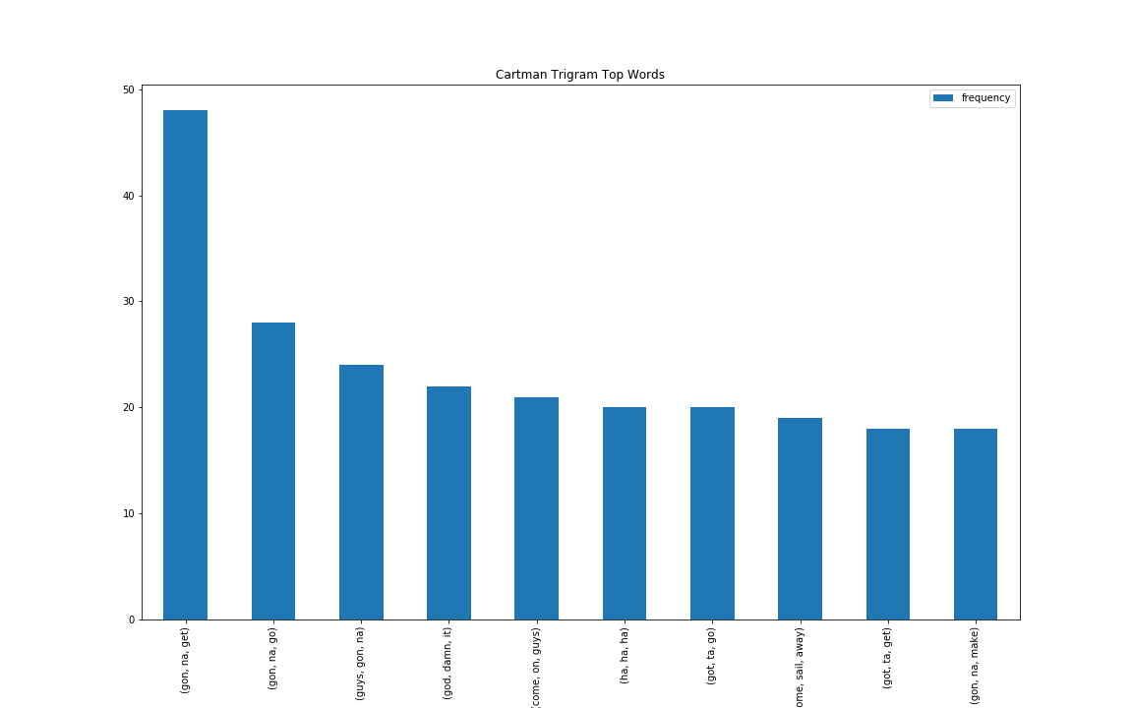
Cartman Trigram Top Words

Slide 13
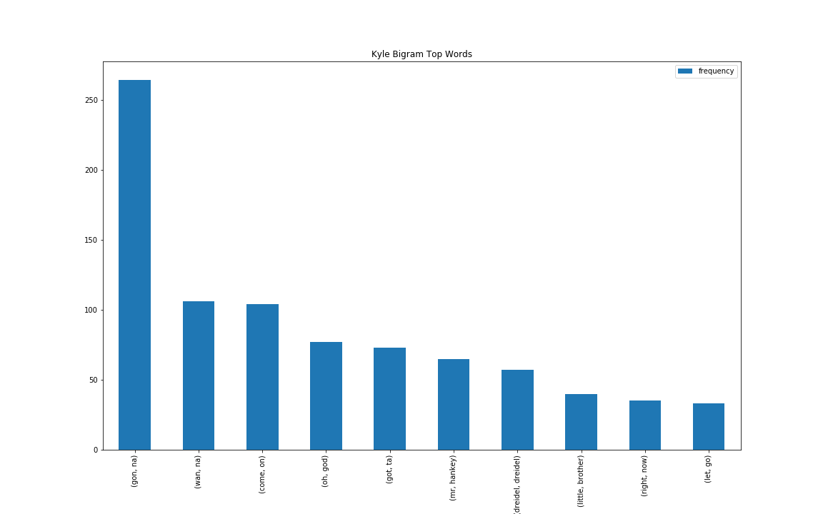
Kyle Bigram Top Words

Slide 14
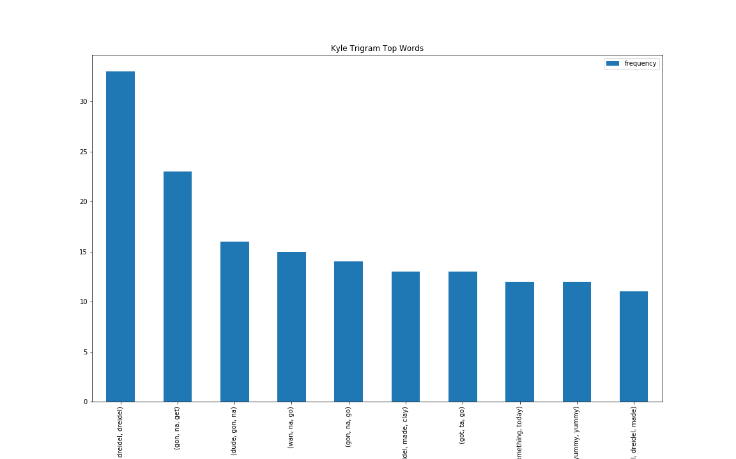
Kyle Trigram Top Words

Slide 15
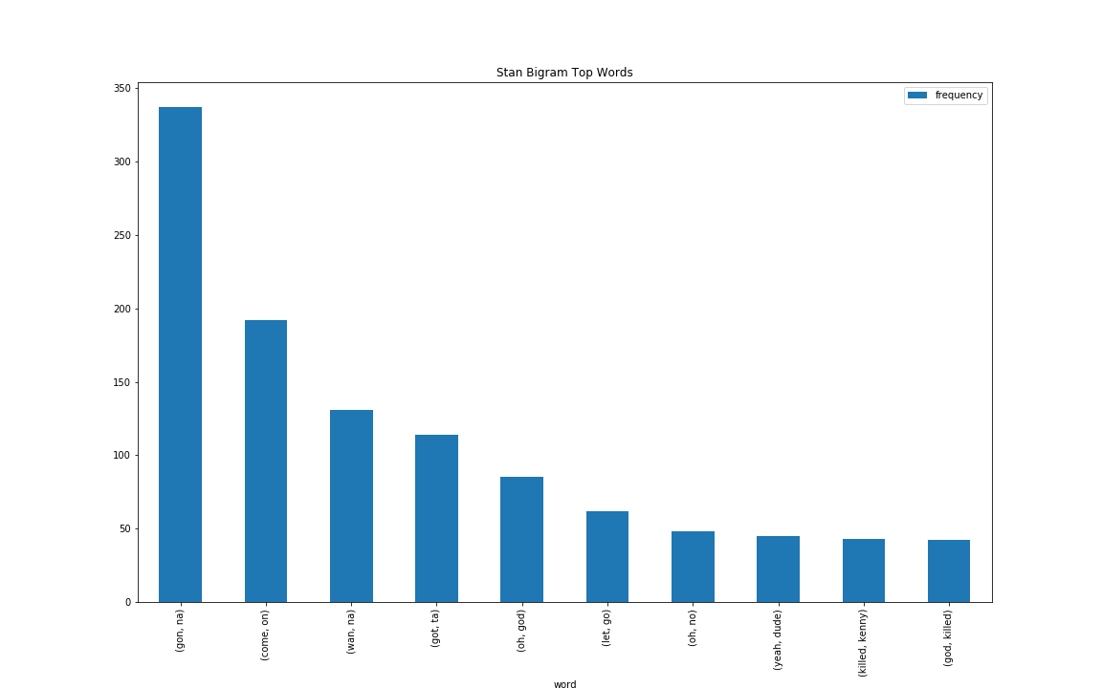
Stan Bigram Top Words

Slide 16
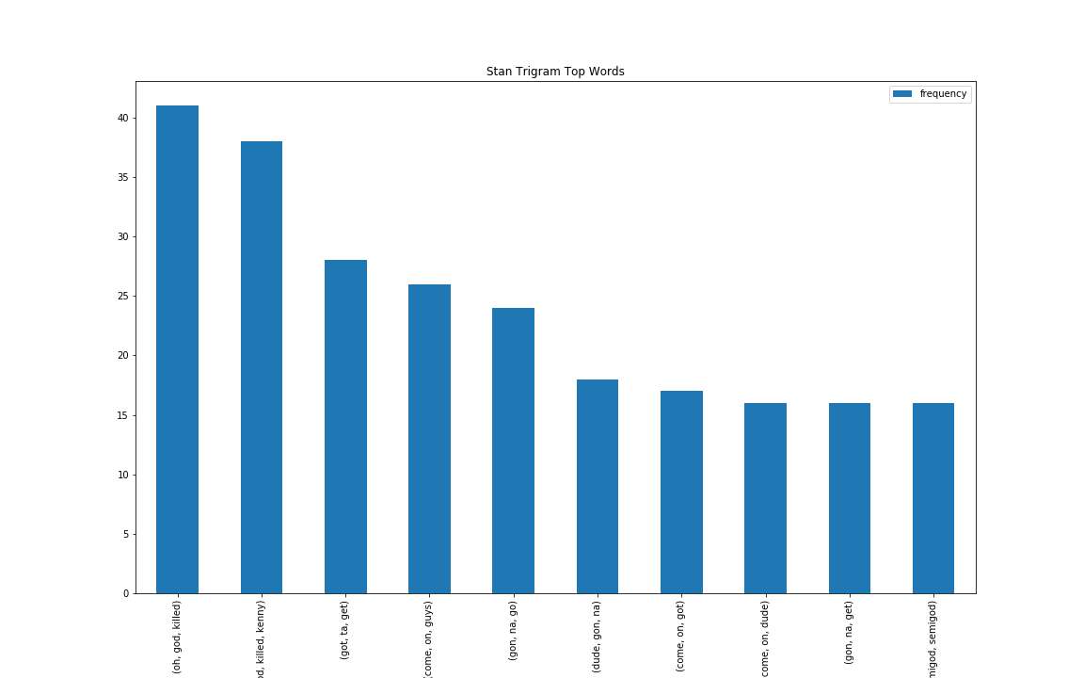
Stan Trigram Top Words

Slide 17
Bag of Words Model
Method of extracting features from text and representing each line of dialogue as a vector or string of numbers.
Taking all the unique words in the dataset, each entry will either have a 1 or 0 value designated that words occurrence.
We call this a bag of words because any information about the order or structure of words in the dataset is discarded.

Slide 18
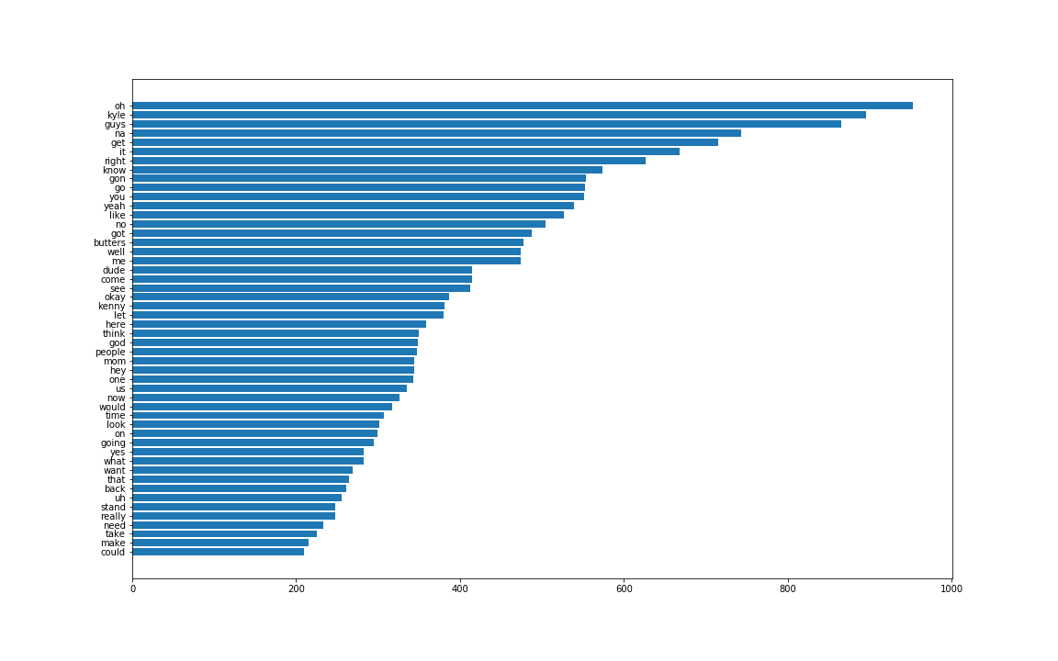
Cartman Bag of Words Top Words

Slide 19
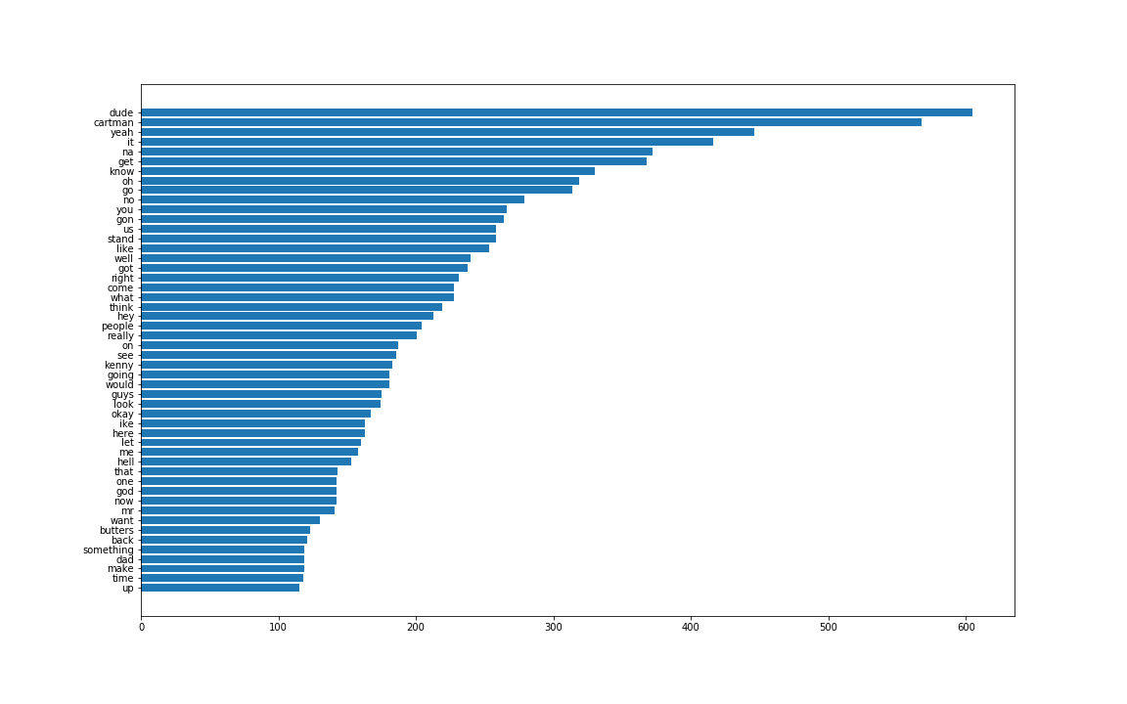
Kyle Bag of Words Top Words

Slide 20
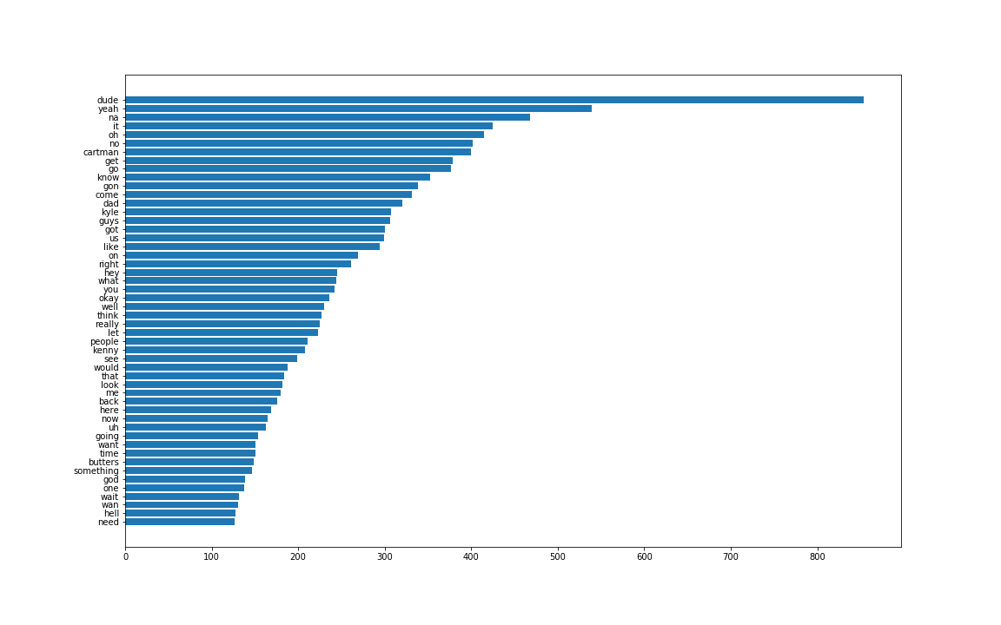
Stan Bag of Words Top Words

Slide 21


TF-IDF Model
Term Frequency - scoring of the frequency of the word in the dataset.
Inverse Document Frequency - scoring of how rare the word is in the dataset.
TF and IDF are multiplied by each other will get a unique numerical value ranging from 0.000 - 1.000 with larger values corresponding to less frequently used words.

Slide 22
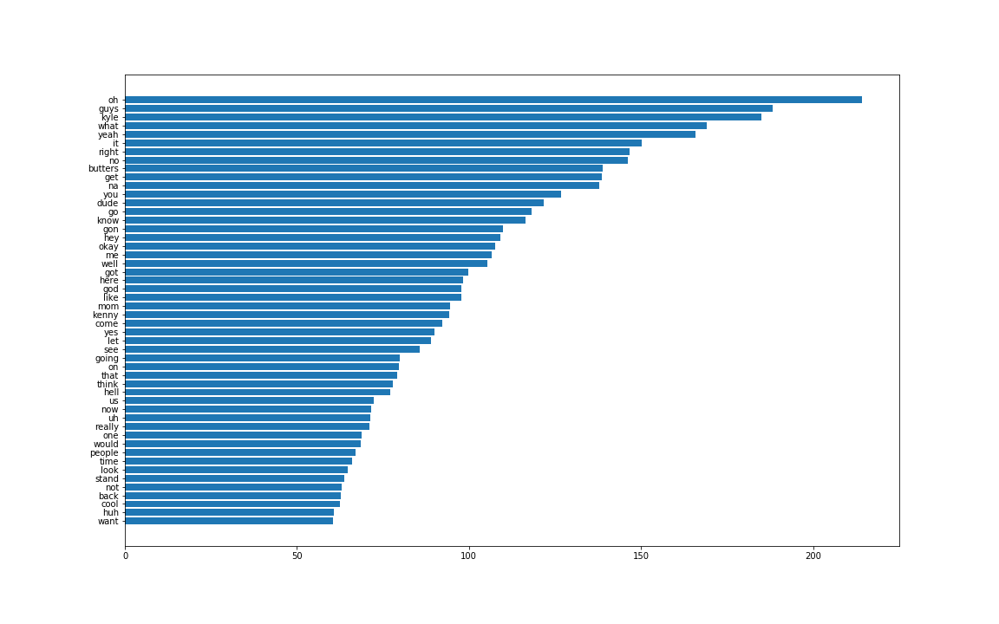
Cartman TF-IDF Top Words

Slide 23
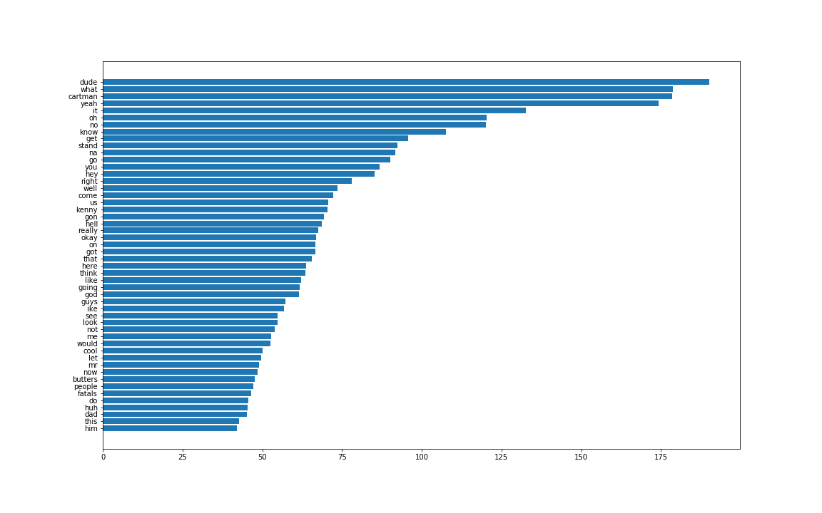
Kyle TF-IDF Top Words

Slide 24
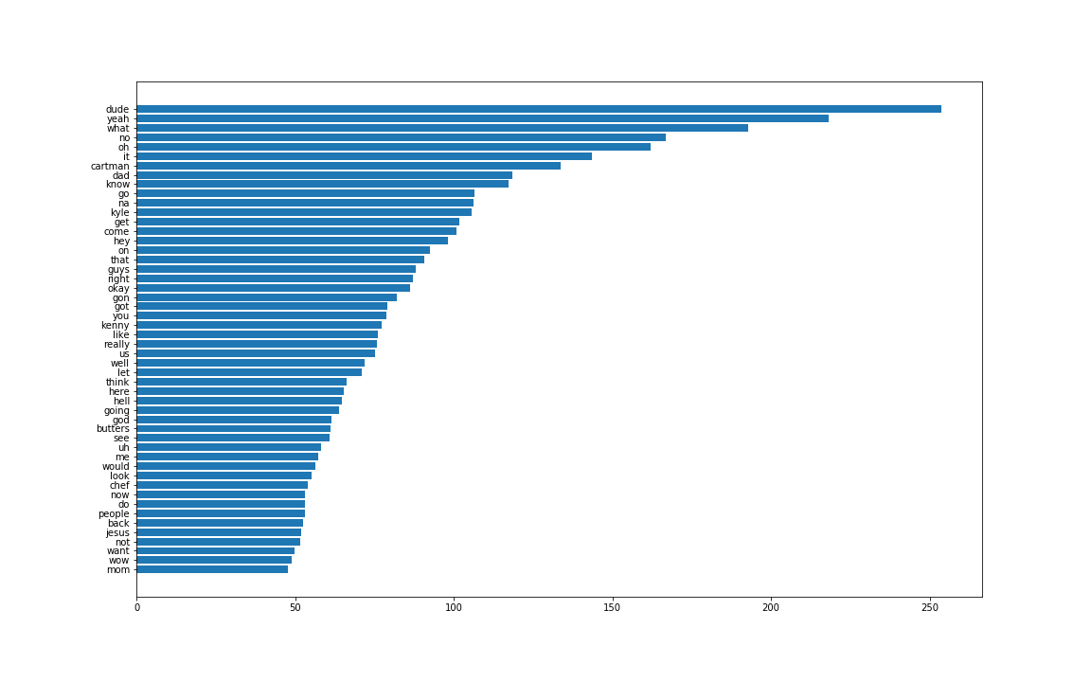
Stan TF-IDF Top Words

Slide 25
Chatbots
The chatbots used in this project are actually simple functions that work by first running the same preprocessing steps on the user input.
Next, we are transforming the string into a vector by creating array and then matching the similarities between the question and response by using pairwise distances.
The response that is chosen will be the one with the highest score in matching the appropriate line of dialogue.

Slide 26
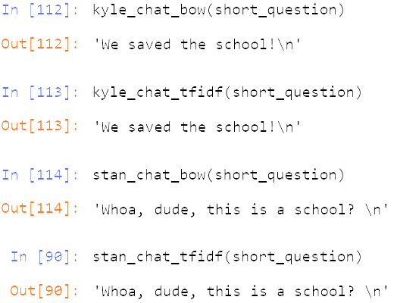
Chatbot Responses
When comparing the difference between the Bag of Words and TF-IDF models we can see that they perform identical when given a single word input. This tells us that when we have only one word to compare with both methods will find the exact same line of dialogue.

Slide 27
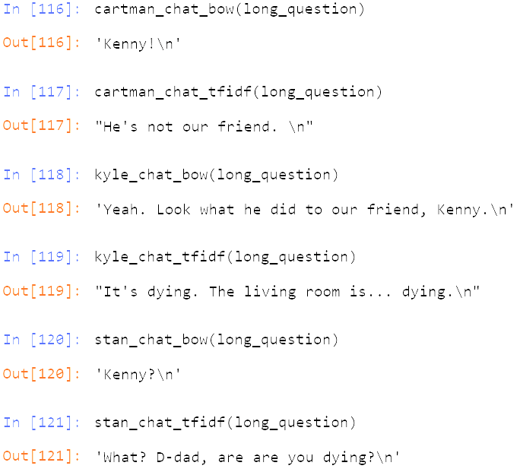
Chatbot Responses
We see a difference when we have a question with multiple words that need to be compared against. Bag of Words will match its response with the line that matches the most words while TF-IDF will match the single word with the highest score and give a line based on that one word.

Slide 28
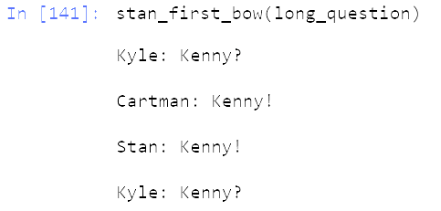
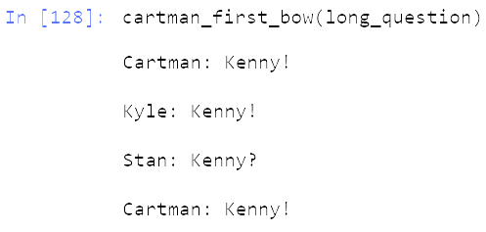
Chatbot Drawbacks
The problem with using dialogue between characters is that we end up with lines of dialogue with only a couple of words. When we tried to have the chatbots talk to each other we have situations where all three chatbots will output the same word since that has the best match but not necessarily the most appropriate.

Slide 29
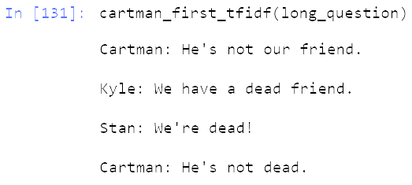
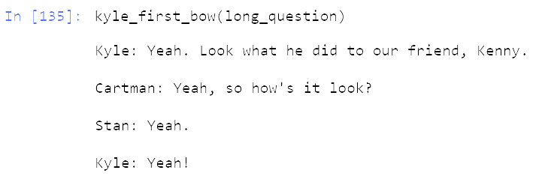
Chatbot Drawbacks
TF-IDF also will match the highest scoring word in the phrase and ignore the other words because they have a lower score.
Bag of Words will match a query with the most simplest response needed to fulfill the requirements.

